Slide 1

PEV – 113 UPPER INTERMEDIATE VERBAL ABILITY
Zero Lecture

Slide 2
Objectives
To acquaint students with the topics that are common in placement tests.
To build the speed of solving the verbal ability section in the same.
To make the students placement ready.
To enhance skills by building confidence.

Slide 3
Course Details Credit : 3
L-T-P
2- 0- 2
L – Lecture T – Tutorial P – Practical /Workshop
Aiming to improve
Study Material
Lecture content
Grammatical and communicative competence
Written and Oral communication
Verbal ability, vocabulary enhancement and reasoning ability
Practical content
Ample worksheets for regular practice.

Slide 4

Course Outcomes
Through this course students should be able to
CO1 :: interpret grammatical structures to enhance the proper use of language in communication
CO2 :: utilize acknowledged grammatical structures and strategies to effectively elaborate on ideas in spoken communication
CO3 :: apply refined writing strategies to elevate professionalism and clarity and peer interaction in correspondence
CO4 :: demonstrate clear communication through language usage in both speaking and writing to excel in society
CO5 :: analyze diverse forms of communication to enhance comprehension skills, integrating vocabulary acquisition
CO6 :: develop life skills by generating engaging communication through the selection of diverse linguistic structures for clarity

Slide 5
Course Assessment Model
Marks Distribution:
Class participation | 15
CA (4 out of 4 tasks) | 30
MTE | 15
ETE | 40
Total | 100

Slide 6
Course content before MTE
Unit I Subject-verb agreement: singular and plural nouns, verbs, rules of subject-verb agreement
Verb tense: introduction to verb tense, rules of verb tense errors
Unit II Voice and Accent: vowels and consonants, word stress, sentence stress
Oral Presentation: purpose, introduction, types and rule of the presentation
Unit III Vocabulary: root words, synonyms and antonyms, contextual vocabulary, phrasal verbs, various exercises based on antonyms and synonyms
Sentence completion: introduction to cloze test, eliminating options using verbal clues, exercises based on cloze test

Slide 7
Course content after MTE
Unit IV Email writing: purpose and functional role of e-mail, structural components of e-mail, do’s and don’ts of e-mail writing
Unit IV Reading comprehension: importance of reading comprehension, types of questions in reading comprehension, reading comprehension questions based on main idea, reading comprehension questions based supporting idea, exercises based on main idea and supporting idea questions
Unit VI Direct and Indirect speech: narration and narrative, descriptive formations, persuasive writing
Para Jumbles: Introduction, rules and types of Para jumbles

Slide 8
UNIT VII Associated Skills • practice worksheets on subject-verb agreement • verb tense games • practice worksheets on sentence completion • practice worksheets on vocabulary • practice worksheets on direct indirect skills • practice worksheets on Para jumbles Speaking skills • understanding job description, adjective placement, summarizing and articulating job description connection between cv and Jd, various parts of cv, cv justification, company-specific key words, adjective and adverb placement • group interaction activities, role plays and simulations

Slide 9
Speaking skills • interview skills: role of passive instructions, useful phrases and clauses, situational competency, selective and attentive listening, panel discussion scenarios • phonic drill on sounds Reading skills • practice sessions on reading comprehension Writing skills • functional aspects of writing • practice exercises on email writing

Slide 10
Exam Mode
MTE UNIT 1,
– MCQ Based
Unit II, and Unit III
❑
ETE –
All 6 units
❑
Third Party Test

Slide 11
Details of Academic Task(s)
 | CA | Objective | Unit Covered | Type | Details of Academic Tasks | Week of Allocation/ conduct
 | CA1 | To assess students spoken and written abilities along with team work | Unit II | Presentation-group | Skill Based Test | 1/9
 | CA2 | To critically monitor the conceptual knowledge of the student. | Unit I and III | MCQs | MCQs of errors based on Subject verb agreement, verb tense, sentence Completion | 3/4
 | CA3 | To acquaint students to the topics that are common in placement papers, evaluate their writing skills. | Unit IV and V | Subjective + MCQs | writing task based on email writing, general topic and speaking task based on speaking task based on project and internship | 10/11
 | CA4 | To critically monitor the concept knowledge of the student | Unit VI | MCQs | MCQs based on direct-indirect, reading comprehension and writing task based on general topics | 12/13

Slide 12
Skill based CA ( Presentation: Group) This assignment will utilize the social media platform Linked In. 1.Students will be divided among groups 2. Students will receive assigned topics based on SDGs for creating their video content. 3. Videos will consist of theme based story/role play/GD 4. Videos must be of 3-5 minutes in length; those exceeding this duration will not be evaluated. 5. Students must upload their videos on their Linked In account as well as in the Google drive 6. Students will be asked questions based on the video in the class.

Slide 13
Evaluation Parameters of Writing:
TASK ACHIEVEMENT
COHERENCE & COHESION
LEXICAL RESOURCES
GRAMMATICAL RANGE & ACCURACY

Slide 14
Evaluation Parameters of Speaking:
VOCABULARY RANGE & CONTROL
COHERENCE & FLUENCY
THEMATIC DEVELOPMENT
PHONOLOGICAL CONTROL
GRAMMATIAL ACCURACY

Slide 15
Programme Outcomes / Salient Features: PO6 : The Engineer and Society : Apply reasoning informed by the contextual knowledge to assess societal, health, safety, legal and cultural issues and the consequent responsibilities relevant to the professional engineering practice. PO9 : Individual and Team Work : Function effectively as an individual, and as a member or leader in diverse teams, and in multidisciplinary settings PO10 : Communication : Communicate effectively on complex engineering activities with the engineering community and with society at large, such as, being able to comprehend and write effective reports and design documentation, make effective presentations, and give and receive clear instructions. PO12 : Life-long Learning : Recognize the need for, and have the preparation and ability to engage in independent and lifelong learning in the broadest context of technological change.

Slide 16
CO PO-Mapping:
Course Outcomes/ Program Outcomes | PO6: The engineer and society:: Apply reasoning informed by the contextual knowledge to assess societal, health, safety, legal and cultural issues and the consequent responsibilities relevant to the professional engineering practice. | PO9 : Individual and team work:: Function effectively as an individual, and as a member or leader in diverse teams, and in multidisciplinary settings. | PO10 : Communication:: Communicate effectively on complex engineering activities with the engineering community and with society at large, such as, being able to comprehend and write effective reports and design documentation, make effective presentations, and give and receive clear instructions. | PO12: Life-long learning:: Recognize the need for, and have the preparation and ability to engage in independent and life- long learning in the broadest context of technological change.

Slide 17
Course Outcomes | PO6: The engineer and society:: | PO9 : Individual and team work:: | PO10 : Communication:: | PO12: Life-long learning::
CO1 :: interpret grammatical structures to enhance the proper use of language in communication | 2(Moderate Mapping Level) | 2(Moderate Mapping Level) | 3(High Mapping Level) | 2(Moderate Mapping Level)
CO2 :: utilize acknowledged grammatical structures and strategies to effectively elaborate on ideas in spoken communication | 2(Moderate Mapping Level) | 2(Moderate Mapping Level) | 3(High Mapping Level) | 2(Moderate Mapping Level)
CO3 :: apply refined writing strategies to elevate professionalism and clarity and peer interaction in correspondence | 2(Moderate Mapping Level) | 2(Moderate Mapping Level) | 3(High Mapping Level) | 2(Moderate Mapping Level)
CO4 :: demonstrate clear communication through language usage in both speaking and writing to excel in society | 2(Moderate Mapping Level) | 2(Moderate Mapping Level) | 3(High Mapping Level) | 2(Moderate Mapping Level)
CO5 :: analyze diverse forms of communication to enhance comprehension skills, integrating vocabulary acquisition | 2(Moderate Mapping Level) | 2(Moderate Mapping Level) | 3(High Mapping Level) | 2(Moderate Mapping Level)
CO6 :: develop life skills by generating engaging communication through the selection of diverse linguistic structures for clarity | 2(Moderate Mapping Level) | 2(Moderate Mapping Level) | 3(High Mapping Level) | 2(Moderate Mapping Level)

Slide 18
CO PO-Mapping:
Course Outcomes/ Program Outcomes | PO6: The engineer and society:: Apply reasoning informed by the contextual knowledge to assess societal, health, safety, legal and cultural issues and the consequent responsibilities relevant to the professional engineering practice. | PO9 : Individual and team work:: Function effectively as an individual, and as a member or leader in diverse teams, and in multidisciplinary settings. | PO10 : Communication:: Communicate effectively on complex engineering activities with the engineering community and with society at large, such as, being able to comprehend and write effective reports and design documentation, make effective presentations, and give and receive clear instructions. | PO12: Life-long learning:: Recognize the need for, and have the preparation and ability to engage in independent and life- long learning in the broadest context of technological change.

Slide 19
MOOC Certification:
Academic Task | Name Of Certification/ Online Course/Test/ Competition mapped | Link of the Course | Type | Offered By Organization
Assignment | Technical English | https://elearn.nptel.ac.in/shop/nptel/english-language-for-competitive-exams/?v=c86ee0d9d7ed) | Test/ Examination | NPTEL+

Slide 20
Star Course-Selection Criteria
•Course focuses on developing professional communication skills enriching students to crack various career pathways.
•This course also helps students to enhance their speaking and comprehension skills in terms of writing as well.
•This course makes students ready to speak fluently and understand others clearly. •This course focuses on even executing their every idea in terms of language well to put across their views clearly.
Pedagogical Initiatives
To enhance communication skills: students will participate in different implementation strategy during practical classes throughout the session.
Monthly online doubt clearing session will be provided to improve the result.
Individual presentation, group discussion, debate and role play will be offered to enhance communication skills.

Slide 21
Topic: Activities | Details of the planned execution strategies
SV Agreement Charades Game | Step 1: Divide the class into two teams. Step 2. Write a sentence on the board with a subject-verb agreement error (e.g., "The team are going to the game."). Step 3:Assign a student from Team A to act out the sentence without speaking. Step 4:Team B has to guess the correct sentence with SV agreement (e.g., "The team is going to the game."). Step 5:If Team B guesses correctly, they earn a point. Step 6: Switch roles and repeat with a new sentence. Step 7: The team with the most points wins.
Start Up Idea pitching: | Step 1- Students will be divided in teams of 4 or more Step 2- They will be given 15 minutes time to prepare a start-up idea keeping in mind various intricacies like product/service details, innovativeness, viability, market study, finances etc. Step 3-They will be given 10 minutes to pitch their idea and advertise it if possible.
Word Association Game | Step 1- Students start with a random word. Step 2.-Each student takes turns writing a word associated with the previous word. Step 3- The game continues until a designated time limit is reached. Step4- Students then share their words and write a short paragraph using as many associated words as possible.

Slide 22
Topic: Activities | Details of the planned execution strategies
Story Chain Game | Step 1- Students sit in a circle. Step 2- They will start sharing their experience based on projects and internships. Step 3- Each student adds one sentence to the story, building on the previous sentence. Step 4- The game continues until a designated time limit is reached. Step 5- Students then share the completed story.
Race against time | Step 1- Students will be given the cloze passage. Step 2- Their task will be to fill in as many blanks and complete as many sentences as possible in the limited time of 60-120 seconds.
Hot Seat | Step 1-.Classwill be divided in 2 teams. Step 2- Choose one student from one team to go to the front of the room and sit in a chair facing the class with his/her back to the board. Step 3- This person is “on the spot.” Place a word on the board so everyone can see it except the person in the chair. Step 4- One at a time, team members give the person a clue about the mystery word. Step 5- If the word is guessed before two minutes are up, the team gets a point and play turns to the other team.

Slide 23
Topic: Activities | Details of the planned execution strategies
Bluff Master | Step 1- Students prepare three statements about themselves, two true and one false. Step 2- They present their statements, and their peers guess which one is the lie. Step 3- The student who convinces the most peers wins.
Would You Rather | Step 1- Students are presented with difficult choices (e.g., "Would you rather be able to fly or be invisible?"). Step 2- They argue for their preference and convince their peers.
Writing Scavenger Hunt | Step 1- Students are given a list of objects or scenes to find and describe. Step 2- They write vivid descriptions of each item on the list. Step 3- The student who completes the most descriptions accurately wins.

Slide 24
Topic: Activities | Details of the Activities Planned
Verbal Interaction | Step 1- In this activity, students are given a topic of discussion. Step 2- The contours of the discussion lie in the hands of the moderator who is the teacher in this case. Step 3- The teacher leads the trajectory of the discussion, at the same time correcting the students on various errors in communication. Step 4- This interaction lasts for 20 minutes. Step 5- Students are given 10 minutes' time for preparation. 2 topics can be done in one class.
Dumb Charades | Step 1- Dumb Charades will be played with the use of lexical resources. Step 2- Class can be divided into teams and scoring can be done accordingly. Step 3- In one case, students can enact the word and his/her team must guess the word. Step 4- In the second case, the student can say everything related to that word like meaning, antonym, synonym etc. But not that word and his/her team has to guess the word. Step 5- In the third case, the student can draw anything related to that word on the board and his/her team must guess the word.

Slide 25
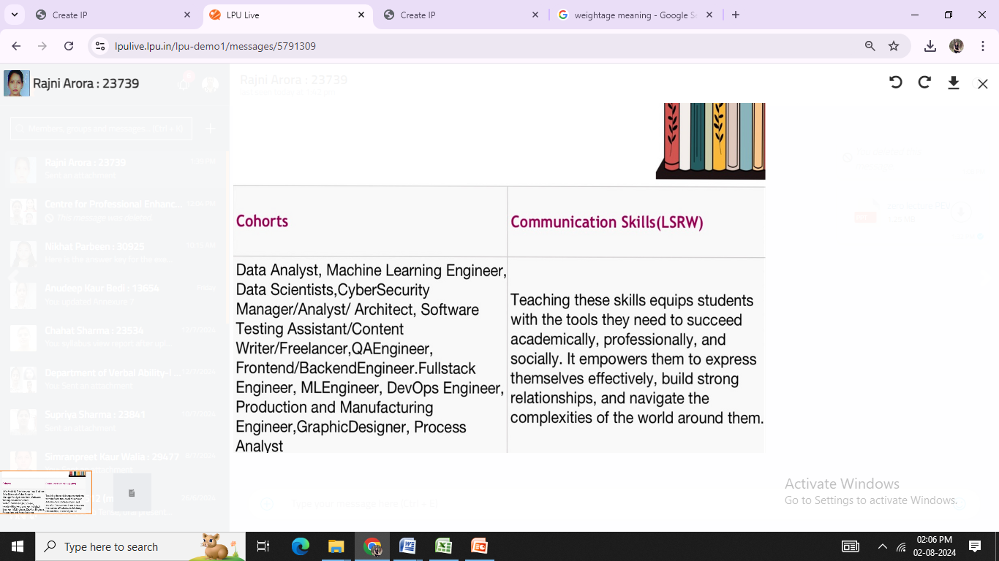
COHORTS : Communication Skills(LSRW) Data Analyst Machine Learning Engineer Data Scientists Cyber Security Manager/Analyst/ Architect Software Testing Assistant/Content Writer/Freelancer QA Engineer Front-end/Backend Engineer Full Stack Engineer ML Engineer DevOps Engineer Production and Manufacturing Engineer Graphic Designer Process Analyst

Slide 26
Reference Books:
R-2 : The Pearson Guide to Verbal Ability and Logical Reasoning for the CAT
Author : Nishit K. Sinha
Publisher : PEARSON

Slide 27
Relevant Websites ( RW )
Sr. No. | (Web address) (only if relevant to the course) | Salient Features
RW-1 | https://www.youtube.com/watch?v=zfbUzWqsH74 | Assists with the rules of subject verb agreement
RW-2 | https://www.youtube.com/watch?v=Ljjiw9mC_Cg | Helps to learn the application of Tenses
RW-3 | https://www.youtube.com/watch?v=TssaA2geuds | Provides the correct pattern of word stress
RW-4 | https://www.youtube.com/watch?v=N5t3NTix1hw | Helps to learn the ways of presentation skills through tips and tricks
RW-5 | https://www.youtube.com/watch?v=0diRbQ-mgfo&pp=ygUgcm9vdCB3b3JkcyBpbiBlbmdsaXNoIHZvY2FidWxhcnk%3D | Helps to learn the root words for better understanding in communication
RW-6 | https://www.youtube.com/watch?v=0diRbQ-mgfo&pp=ygUgcm9vdCB3b3JkcyBpbiBlbmdsaXNoIHZvY2FidWxhcnk%3D | Helps to inculcate the knowledge of synonyms & antonyms
RW-7 | https://www.youtube.com/watch?v=mCMN9geluV0&pp=ygUSY2xvemUgdGVzdCBlbmdsaXNo | Assists to enhance the ability to comprehend passages through cloze Test

Slide 28
Sr. No. | (Web address) (only if relevant to the course) | Salient Features
RW-8 | https://www.youtube.com/watch?v=rGrH-IGHS9w&t=38s&pp=ygUdZW1haWwgd3JpdGluZyBmb3JtYWwgaW5mb3JtYWw%3D | Helps to learn the formal way of communication through email writing
RW-9 | https://youtu.be/dHQermxTTf0?si=3qCKQzGdjbyt4qBd https://www.youtube.com/watch?v=dPvWRYPadFg&pp=ygUgcmVhZGluZyBjb21wcmVoZW5zaW9uIHN0cmF0ZWdpZXM%3D https://www.youtube.com/watch?v=dPvWRYPadFg&pp=ygUgcmVhZGluZyBjb21wcmVoZW5zaW9uIHN0cmF0ZWdpZXM%3D | Helps to enhance the mental ability with the help of reading comprehension
RW-10 | https://www.youtube.com/results?search_query=reading+comprehension+main+idea | Assists to identify different techniques of getting main idea and supporting idea
RW-11 | https://youtu.be/dHQermxTTf0?si=3qCKQzGdjbyt4qBdhttps://youtu.be/dHQermxTTf0?si=3qCKQzGdjbyt4qBdhttps://www.youtube.com/watch?v=dPvWRYPadFg&pp=ygUgcmVhZGluZyBjb21wcmVoZW5zaW9uIHN0cmF0ZWdpZXM%3D | Assists to identify the rules to convey information through narration techniques enhancing the mental ability with the help of reading comprehension
RW-12 | https://byjus.com/govt-exams/direct-indirect-speech-rules/ | Helps to learn different ways of descriptive and persuasive writing
RW-13 | https://www.youtube.com/watch?v=CHWzPBXH4_8&pp=ygULcGFyYWp1bWJsZXM%3D | Helps to enhance problem solving and critical thinking through para jumbles
RW-14 | https://www.geeksforgeeks.org/tips-and-tricks-to-solve-para-jumbles/ | Helps to learn different techniques of solving para jumbles

Slide 29
Open Educational Resources(OER)
Unit mapped | Broad topic | Source Type | Source Title | *%age mapping (approx) | Source URL
Unit 1 | 1)Subject-verb agreement 2)Verb tense: | Online | Video lecture | 100% | 1)https://youtu.be/S8Q-8Je-Ml4?si=8h5TPLpLds4gvNIX 2) https://youtube.com/playlist?list=PLD6B222E02447DC07&si=e-JoB4ayhg5_4Q0Q
Unit 2 | 1.Oral Presentation 2.voice and accent | Online | Video lecture | 100 % | 1)https://youtu.be/9p1kfkpsYzQ?si=LF9wkabFOOx2psqk 2) https://youtube.com/playlist?list=PLD6B222E02447DC07&si=e-JoB4ayhg5_4Q0Q
Unit 3 | 1.Vocabulary 2.sentence Completion | Online | worksheets | 100 % | 1)https://www.englishclub.com/esl-quizzes/vocabulary/ 2)https://ielts-up.com/reading/sentence-completion-lesson.html

Slide 30
Open Educational Resources(OER)
Unit mapped | Broad topic | Source Type | Source Title | *%age mapping (approx) | Source URL
Unit 4 | 1.E-mail Writing 2.Direct and Indirect | Online | worksheets | 100 % | 1)https://www.bbc.co.uk/learningenglish//features/office-english/240129 2)https://byjus.com/govt-exams/direct-indirect-speech-rules/
Unit 5 | Reading Comprehension | Online | Video Lecture | 100 % | https://youtu.be/xrEq-1UujOo?si=PGmZ5_LEr7wmtvNH
Unit 6 | Para Jumbles | Online | Worksheet | 100 % | https://www.bankexamstoday.com/2017/09/rules-to-solve-parajumbles-with-examples.html

Slide 31
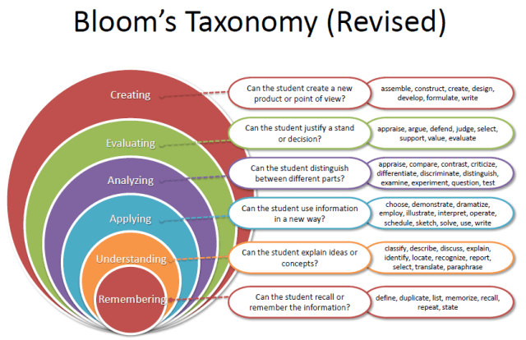
Revised Bloom’s Taxonomy

Slide 32
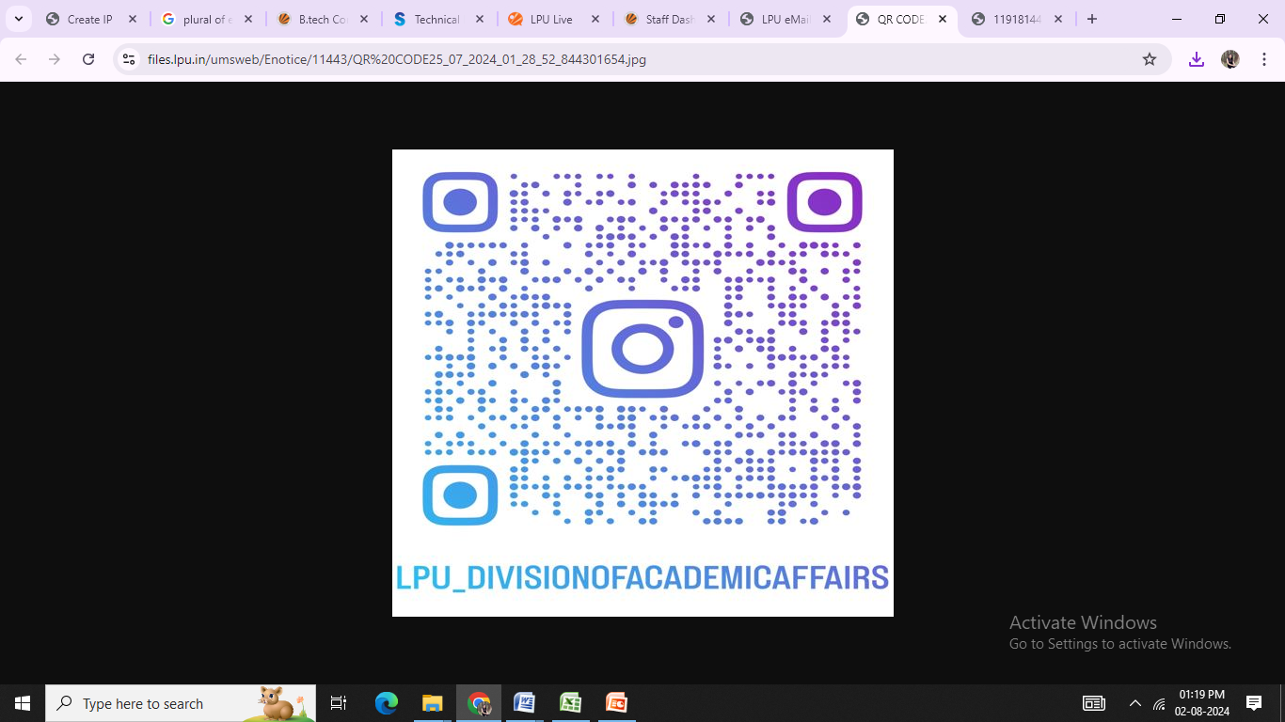
Social Media page of DAA:

Slide 33
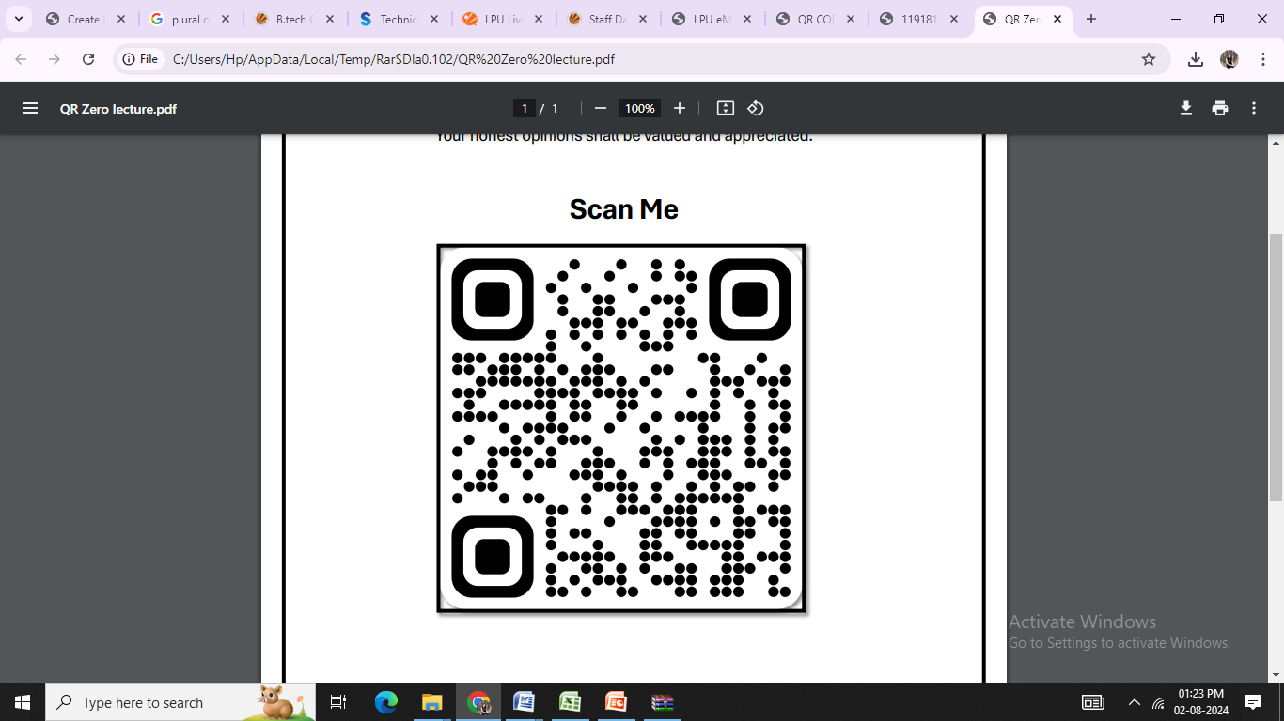
QR Code for Zero lecture feedback:

Slide 34
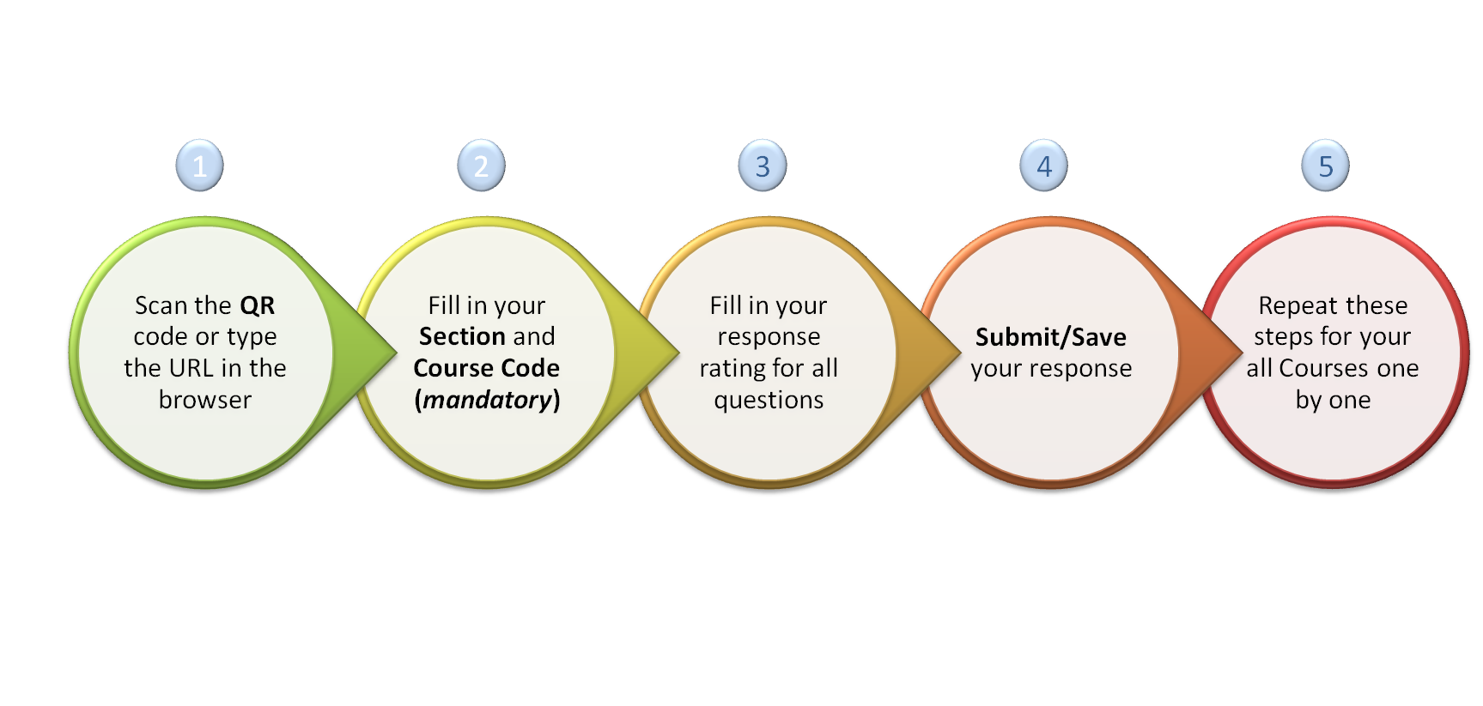
Steps to fill the Zero lecture feedback:
QR codes are available on notice boards outside your classrooms as well as on main notice board of your teaching block.
A ‘my message’ is also available in your UMS account containing feedback link.

Slide 35
FEEDBACK PROCESS
Zero Lecture
In 2nd Week On GOOGLE FORM

Slide 36
Feedback Process
Teaching & Pedagogy
After the class on UMS

Slide 37
Students’ Role
Always communicate in English with your friends and in other classes too
Be enthusiastic in participating in classroom activities and attempt practice tests for better understanding and performance.
Actively participate in solving worksheets and interaction in the class.
‘Brevity is the soul of wit’, so try to convey your ideas in few words.
Utilize accurate vocabulary while communicating for better emphasis.
Ask volley of questions whenever there arises a doubt in your mind.
Reading enhances speaking, so make the habit of reading newspapers.

Slide 38
Thank You

